Slide 1
Conversation Class
Lyrics
Christopher bAUMAN

Slide 2
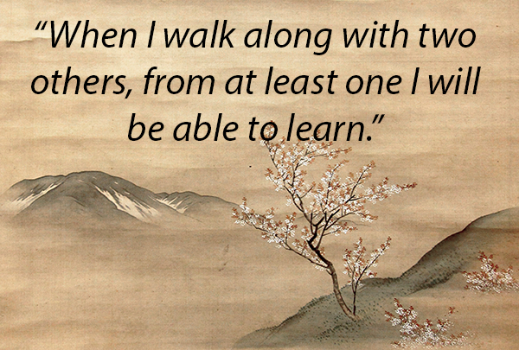
Education Infographic
Chris Bauman

